Slide 1
Java Programming
Dept of CSE
2013 Series

Slide 2
Dialog Box: JOptionPane
Confirm Dialog Box
Int option=0;
option=JOptionPane.showConfirmDialog(null,“Continue");
System.out.println(option);
Input Dialog Box
String option1=JOptionPane.showInputDialog("Enter a value");
int data=Integer.parseInt(option1);
System.out.println(option1);

Slide 3
Dialog Box: JOptionPane
Message Dialog Box
JOptionPane.showMessageDialog(null,“text");
Program
Input two integers from keyboard then add them using dialog box.

Slide 4
Immutable Class
Normally, we create object and allow its content to be changed later.
Sometimes, it is desirable to create an object whose content can't be changed once the object is created

Slide 5
Example: Immutable class
public class Student{
private int roll;
private String name;
public int showRoll(){ return roll;}
public String showName()(return name;}
};

Slide 6
The this Reference
It refers to the calling object itself.
It used to refer the hidden/private data members
The static data members are accessed by the ClassName.cv

Slide 7
The static variable
It refers to the class variable.
Common location for all the instances of a particular class

Slide 8
Example: this & static
import javax.swing.*;
import java.math.*;
import java.util.*;
class Foo{
private
int i=4;
static double k=0;
public
void setI(int i){this.i=i;}
static void setK(){++Foo.k;}
int getI(){return i;}
double getK(){return k;}
}
public class myInput {
public static void main(String[] args) {
// TODO Auto-generated method stub
Foo f1=new Foo();
Foo f2=new Foo();
f1.setK();
f2.setK();
System.out.println(f2.getK());
}
}

Slide 9
Inheritance & Polymorphism
Inheritance: New class can be created from existing class
Suppose a class C1 extended from class C2 then C1 is called the subclass and C2 is called the supper class.
Subclass is also named as child/extended/derived class
Supperclass is also named as parent/base class

Slide 10
A subclass inherits all the members (fields, methods, and nested classes) from its superclass. Constructors are not members, so they are not inherited by subclasses, but the constructor of the superclass can be invoked from the subclass.

Slide 11
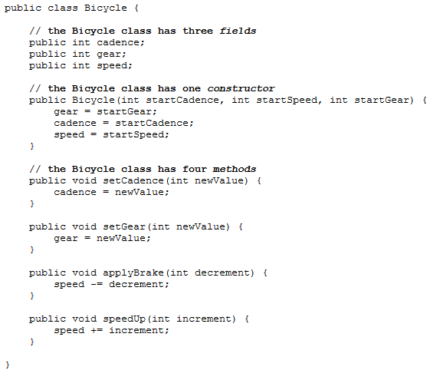
An Example of Inheritance

Slide 12
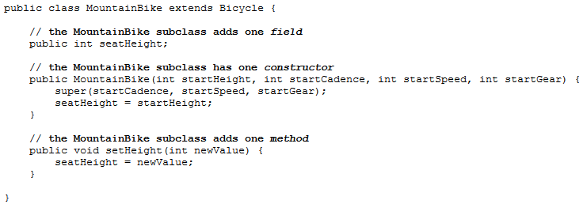
A class declaration for a MountainBike class that is a subclass of Bicycle might look like this:

Slide 13
Example: extended JFrame class
import javax.swing.*;
import java.math.*;
import java.util.*;
class CustomeFrame extends JFrame{
public CustomeFrame(){
this.setTitle("******MY Window ******");
this.setLocation(200, 100);
this.setSize(500, 400);
this.setVisible(true);
}
}
public class myInput {
public static void main(String[] args) {
// TODO Auto-generated method stub
CustomeFrame frame=new CustomeFrame();
CustomeFrame frame1=new CustomeFrame();
}
}

Slide 14
What You Can Do in a Subclass?
The inherited fields can be used directly, just like any other fields.
You can declare new fields in the subclass that are not in the superclass.
The inherited methods can be used directly as they are.

Slide 15
You can write a new instance method in the subclass that has the same signature as the one in the superclass, thus overriding it.
You can declare new methods in the subclass that are not in the superclass.
You can write a subclass constructor that invokes the constructor of the superclass, either implicitly or by using the keyword super.

Slide 16
Example: super keyword
import javax.swing.*;
import java.math.*;
import java.util.*;
public class myInput {
public static void main(String[] args) {
Subclass s = new Subclass();
s.printMethod();
}
}
class Superclass {
Superclass(){System.out.println("Inside super");}
Superclass(int x){System.out.println("Inside super x");}
public void printMethod() {
System.out.println("Printed in Superclass.");
}
}
//Here is a subclass, called Subclass, that overrides printMethod():
class Subclass extends Superclass {
public Subclass(){
super(20); //first line in the subclass constructor
System.out.println("Inside sub");
}
public void printMethod() {
super.printMethod();
System.out.println("Printed in Subclass");
}
}

Slide 17
Overridden Methods
Sometimes it is necessary for the subclass to modify the implementation of a method defined in superclass. This is referred to as overridden method.

Slide 18
Overridden vs Overloading
public class myInput {
public static void main(String[] args) {
A a=new A();
a.p(10);
}
}
class B{
public void p(int i){}
}
class A extends B{
//overridden method
public void p(int i){System.out.println("Inside A");}
}

Slide 19
Overridden vs Overloading
public class myInput {
public static void main(String[] args) {
A a=new A();
a.p(10);
}
}
class B{
public void p(int i){}
}
class A extends B{
//Method p() is overloaded
public void p(double i){System.out.println("Inside A");}
}

Slide 20
Object class
Every class in Java is descended from the java Object class
public class Circle{} is equivalent to
public class Circle extends Object
public String toString() is a method of Object class

Slide 21
Polymorphism
Polymorphism means “Many forms”
It simply means that a variable of supertype can refer to variable of subtype

Slide 22
Example: Polymorphism
public class myInput {
public static void main(String[] args) {
m(new GraduateStudent());
m(new Student());
m(new Person());
m(new Object());
}
public static void m(Object x){System.out.println(x.toString());
}
}
class GraduateStudent extends Student{}
class Student extends Person{
public String toString(){
return "student";
}
}
class Person extends Object{
public String toString(){
return "person";
}
}

Slide 23
Dynamic Binding
Which implementation is used will be determined dynamically by the JVM. This capability is known as dynamic binding.
Cp
Cp-1
C2
C1
Object class

Slide 24
Abstract class
Sometimes a superclass is so specific/abstract that it cannot have any specific instances. Such class is referred to as an abstract class.

Slide 25
Object cannot be created from abstract class
An abstract class cannot be instantiated using the new operator, but you can still define its constructors, which are invoked in the constructors of its subclasses. For instance, the constructors of GeometricObject are invoked in the Circle class and the Rectangle class.
25

Slide 26
Abstract Classes and Abstract Methods
26

Slide 27
Example: Abstract class
package Day1.Example;
import javax.swing.*;
import java.math.*;
import java.util.*;e
public class myInput {
public static void main(String[] args) {
GeometricObject cir=new Circle(5);
GeometricObject rec=new Rectangle(3,4);
cir.setColor("RED");
cir.setFilled(true);
System.out.println(cir.getArea()+" and color="+cir.getColor());
System.out.println("rect="+rec.getArea());
if(cir.isFilled())
{System.out.println("Filled");}
else
{System.out.println("Not Filled");}
}
}

Slide 28
Example: continued
abstract class GeometricObject{
private String color="White";
private boolean filled;
public String getColor(){ return color;}
public void setColor(String color){this.color=color;}
public boolean isFilled(){return filled;}
public void setFilled(boolean filled){this.filled=filled;}
public abstract double getArea();
}
class Circle extends GeometricObject{
private double radius;
public Circle(){};
public Circle(double radius){this.radius=radius;}
public double getArea(){return Math.PI*radius*radius;}
}
class Rectangle extends GeometricObject{
private double width;
private double length;
public Rectangle(){};
public Rectangle(double width, double length){this.width=width;this.length=length;}
public double getArea(){return width*length;}
}

Slide 29
Interfaces
What is an interface?
Why is an interface useful?
How do you define an interface?
How do you use an interface?
29

Slide 30
What is an interface? Why is an interface useful?
An interface is a classlike construct that contains only constants and abstract methods. In many ways, an interface is similar to an abstract class, but the intent of an interface is to specify behavior for objects. For example, you can specify that the objects are comparable, edible, cloneable using appropriate interfaces.
30

Slide 31
Define an Interface
To distinguish an interface from a class, Java uses the following syntax to define an interface:
public interface InterfaceName {
constant declarations;
method signatures;
}
Example:
public interface Edible {
/** Describe how to eat */
public abstract String howToEat();
}
31

